Slide 1
Algorithm
Definition: An algorithm is a finite sequence of instructions, a logical and explicit step-by-step
procedure for solving a problem starting from a known beginning.

Slide 2
Qualities of a good algorithm
Inputs and outputs should be defined precisely.
Each step in algorithm should be clear and unambiguous.
Algorithm should be most effective among many different ways to solve a problem.
An algorithm shouldn't have computer code. Instead, the algorithm should be written in such a way that, it can be used in similar programming languages.
The solution must follow a logical path: the order of the instructions is important

Slide 3
Example Of Algorithm In Programming
Write an algorithm to add two numbers entered by user.
Step 1: Start
Step 2: Declare variables num1, num2 and sum.
Step 3: Read values num1 and num2.
Step 4: Add num1 and num2 and assign the result to sum.
sum←num1+num2
Step 5: Display sum
Step 6: Stop

Slide 4
Defining Pseudocode
Pseudocode is a simple way of writing programming code in English.
Pseudocode is not actual programming language. It uses short phrases to write code for programs before you actually create it in a specific language.
Once you know what the program is about and how it will function, then you can use pseudocode to create statements to achieve the required results for your program.

Slide 5
Example of Pseudocode
Create a program to add 2 numbers together and then display the result.
Start Program Enter two numbers, A, B Add the numbers together Print Sum End Program

Slide 6
Flow Chart
Definition:
Simply said, flow chart is a block diagram, describing an algorithm.
It displays the sequence of steps that you need to do to complete a given task.

Slide 7
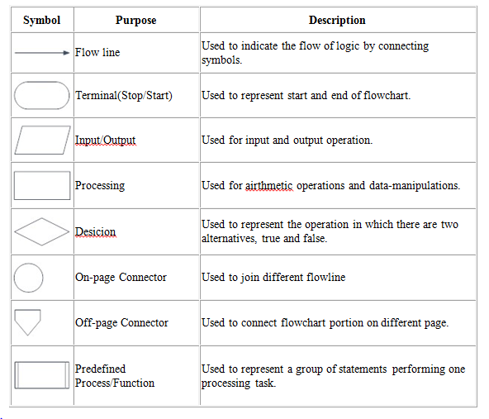
Symbols Used In Flowchart

Slide 8
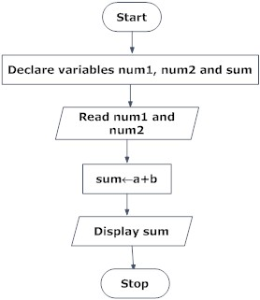
Example of flowchart in programming
Draw a flowchart to add two numbers entered by user.

Slide 9
Program Development Life Cycle
When we want to develop a program using any programming language, we follow a sequence of steps.
These steps are called phases in program development.
The program development life cycle is a set of steps or phases that are used to develop a program in any programming language.

Slide 10
Program Development Life Cycle
Generally, program development life cycle contains 6 phases, they are as follows….
Problem Definition
Problem Analysis
Algorithm Development
Coding & Documentation
Testing & Debugging
Maintenance

Slide 11
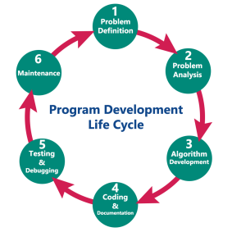
Program Development Life Cycle

Slide 12
Program Development Life Cycle
Problem Definition
In this phase, we define the problem statement and we decide the boundaries of the problem.
In this phase, we need to understand the problem statement, what is our requirement, what should be the output of the problem solution.
These are defined in this first phase of the program development life cycle.

Slide 13
Program Development Life Cycle
2. Problem Analysis
In phase 2, we determine the requirements like variables, functions, etc. to solve the problem.
That means we gather the required resources to solve the problem defined in the problem definition phase.
We also determine the bounds of the solution.

Slide 14
Program Development Life Cycle
3. Algorithm Development
During this phase, we develop a step by step procedure to solve the problem using the specification given in the previous phase.
This phase is very important for program development.
That means we write the solution in step by step statements.

Slide 15
Program Development Life Cycle
4. Coding & Documentation
This phase uses a programming language to write or implement actual programming instructions for the steps defined in the previous phase.
In this phase, we construct actual program.
That means we write the program to solve the given problem using programming languages like C, C++, Java etc.,

Slide 16
Program Development Life Cycle
5. Testing & Debugging
During this phase, we check whether the code written in previous step is solving the specified problem or not.
That means we test the program whether it is solving the problem for various input data values or not.
We also test that whether it is providing the desired output or not.

Slide 17
Program Development Life Cycle
6. Maintenance
During this phase, the program is actively used by the users.
If the user encounters any problem or wants any enhancement, then we need to repeat all the phases from the starting, so that the encountered problem is solved or enhancement is added.

Slide 18
Translator
A program written in high-level language is called as source code. To convert the source code into machine code, translators are needed.
A translator takes a program written in source language as input and converts it into a program in target language as output.
It also detects and reports the error during translation.

Slide 19
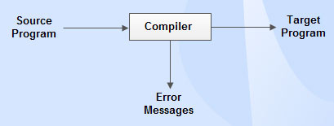
Different types of translators
Compiler:
Compiler is a translator which is used to convert programs in high-level language to low-level language.
It translates the entire program and also reports the errors in source program encountered during the translation.

Slide 20
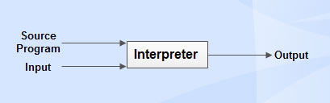
Different types of translators
Interpreter
Interpreter is a translator which is used to convert programs in high-level language to low-level language.
Interpreter translates line by line and reports the error as soon as it is encountered during the translation process.
It gives better error diagnostics than a compiler.

Slide 21
Differences between compiler and interpreter
S. No | Compiler | Interpreter
1 | Performs the translation of a program as a whole. | Performs translation statement by statement .
2 | Execution is faster. | Execution is slower.
3 | Requires more memory as linking is needed for the generated intermediate object code. | Memory usage is efficient as no intermediate object code is generated.
4 | Debugging is hard as the error messages are generated after scanning the entire program only. | It stops translation when the first error is met. Hence, debugging is easy.
5 | Programming languages like C, C++ uses compilers. | Programming languages like Python, BASIC, and Ruby uses interpreters.

Slide 22

Different types of translators
Assembler
Assembler is a translator which is used to translate the assembly language code into machine language code.

Slide 23
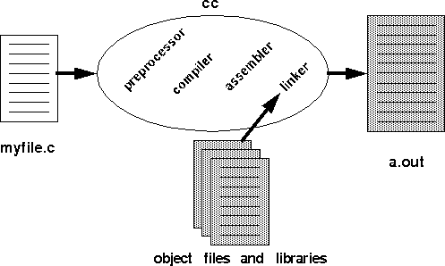
Compiling a Program
There are four entities involved in the compilation process: preprocessor, compiler, assembler, linker

Slide 24
Compiling a Program
First, the C preprocessor expands all those macros definitions and include statements (and anything else that starts with a #) and passes the result to the actual compiler.
The compiler effectively translates preprocessed C code into assembly code, performing various optimizations along the way as well as register allocation.
The assembly code generated by the compilation step is then passed to the assembler which translates it into machine code; the resulting file is called an object file. An object file is a binary representation of your program.
It is the job of the linker to assign memory locations to everything and resolve any unresolved references. The linker produces a binary executable that can be run from the command interface.

Slide 25
Running a Program
When you type ./a.out at the command line, a whole bunch of things must happen before your program is actually run.
The loader magically does these things for you.
On UNIX systems, the loader creates a process. This involves reading the file and creating an address space for the process.
Then the loader executes a jump instruction to the first instruction in the program.
This generally causes a page fault and the first page of your instructions is brought into memory.

Slide 26
Introduction to C Language
C is a general-purpose high level language that was originally developed by Dennis Ritchie for the Unix operating system.
The Unix operating system and virtually all Unix applications are written in the C language.
C has now become a widely used professional language for various reasons.
Easy to learn
Structured language
It produces efficient programs
It can be compiled on a variety of computers.

Slide 27
Facts about C
C was invented to write an operating system called UNIX.
C is a successor of B language which was introduced around 1970
The language was formalized in 1988 by the American National Standard Institute (ANSI).
By 1973 UNIX OS was almost totally written in C.
Today C is the most widely used System Programming Language.
Most of the state of the art software have been implemented using C

Slide 28
Steps to Compile and Execute C Program
Open a text editor and write the code.
Save the file with .c extension such as hello.c
Open a command prompt and go to the directory where you have saved the file.
Type gcc hello.c and press enter to compile your code.
If there are no errors in your code, the command prompt will take you to the next line and would generate executable file.
Now, type ./a.out to execute your program.
You will see the output printed on the screen.

Slide 29
Data Types
Data Type | Size (In Bytes)
Char | 1
Signed Char | 1
Unsigned Char | 1
Int | 2 or 4
Unsigned Int | 2 or 4
Short (Int) | 2
Unsigned Short | 2
Float | 4 or 8
Double | 8
Long Double | 10

Slide 30
To get the size of a data type
#include <stdio.h>
#include <limits.h>
void main()
{
printf("Storage size for int : %d \n", sizeof(int));
}

